Slide 1

Linux Signal-Based Process Communication and Control System Course: Operating Systems and Systems Programming Course Code: 25CS2104E | Section: 1 | Team No: 7 Team Members: 2520030411 - Manaswi 2520030517 – Nithya 2520030272 – Sri Lakshmi

Slide 2
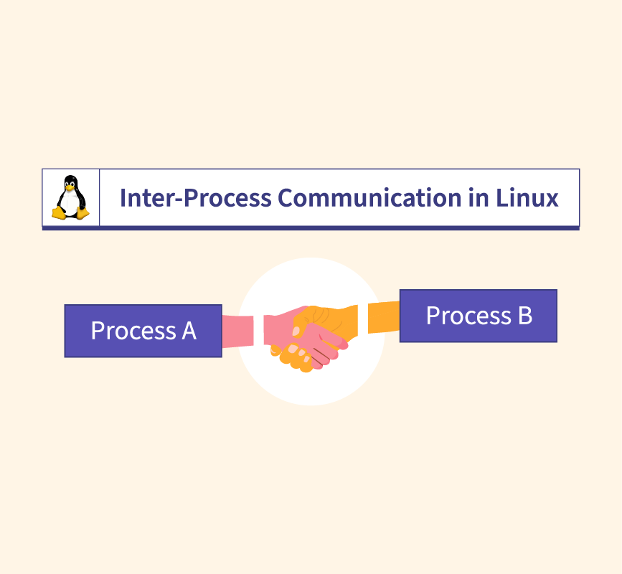
Abstract
Linux Signal-Based Process Communication and Control System is a Linux-based project that demonstrates inter-process communication and process control using signals. The system enables a parent process to communicate with and control child processes using signals such as SIGUSR1, SIGUSR2, SIGINT, and SIGTERM. It uses system calls like fork(), kill(), and signal handlers to perform actions such as process notification, status checking, pausing, and safe termination. The project provides practical understanding of Linux process management, signal handling, synchronization, and IPC, making it useful for learning core Operating System concepts.

Slide 3
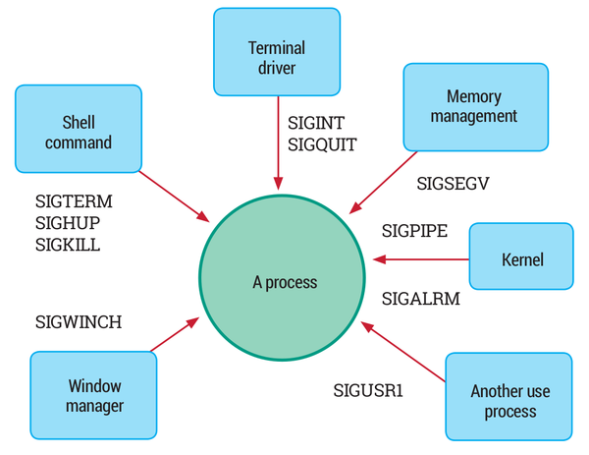
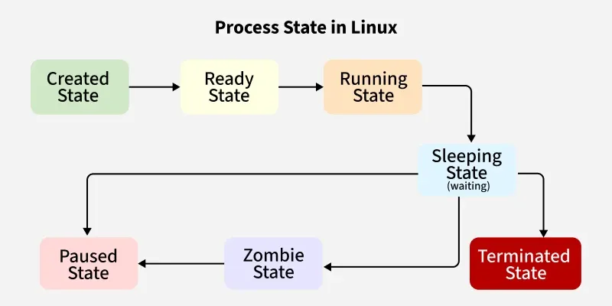
Problem Statement
Managing communication and control between multiple processes in Linux can be challenging without an efficient mechanism. This project aims to use Linux signals for inter-process communication, allowing processes to send commands, respond to events, monitor status, and terminate safely. It demonstrates a simple and effective approach to process management and IPC.

Slide 4
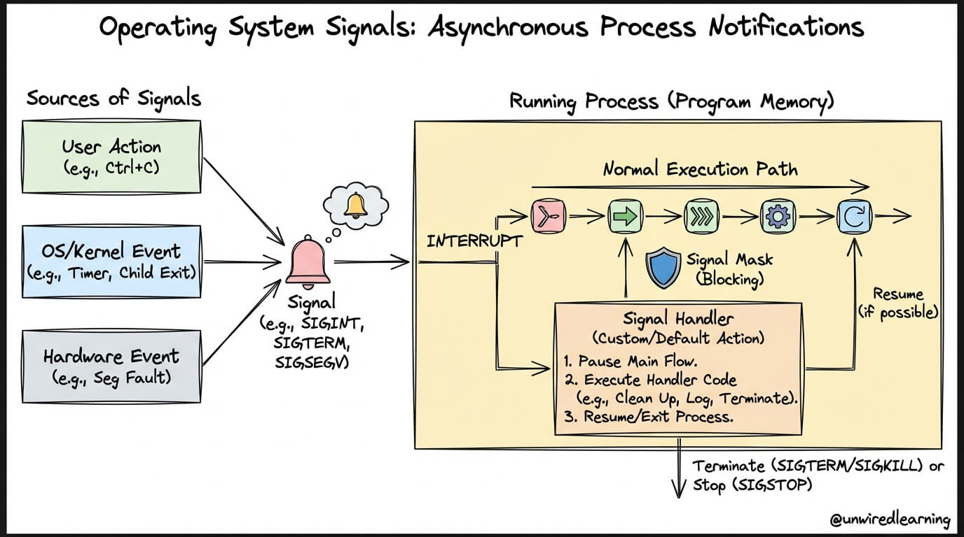
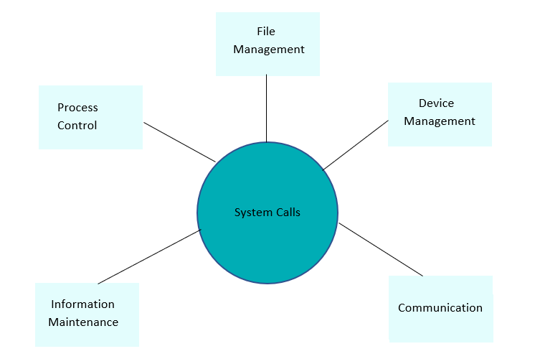
Objectives
To understand Linux process management and IPC.
To implement signal-based communication between processes.
To use signals for process control and monitoring.
To implement signal handling for different events.
To enable safe process termination.
To gain practical knowledge of Linux system calls.

Slide 5
Proposed Methodology
Create Processes – Use fork() to create parent and child processes.
Register Signals – Set signal handlers for signals like SIGUSR1, SIGUSR2, and SIGTERM.
Send Signals – Use kill() to send commands between processes.
Handle Signals – Perform specific actions when signals are received.
Monitor Processes – Display process status and responses.
Terminate Safely – Use appropriate signals to stop processes safely.

Slide 6
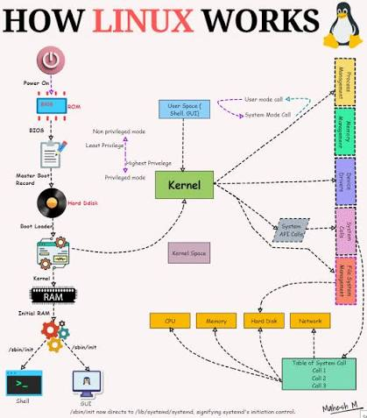
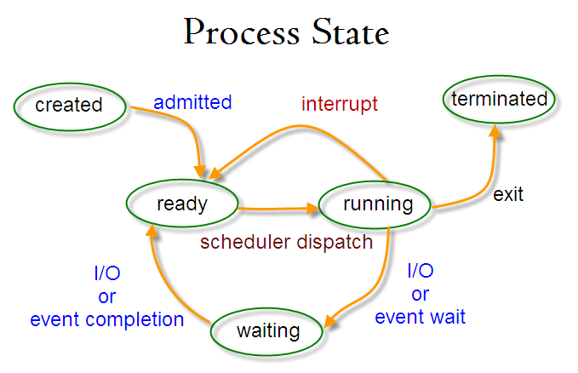
Project Workflow
1. START 2. Initialize Linux System 3. Create Parent & Child Processes 4. Register Signal Handlers 5. Send Control Signals 6. Receive & Identify Signal 7. Execute Required Action (Pause / Resume / Status / Terminate)Monitor Process Response 8. Safe Process Termination
END Simple flow: START → CREATE → CONNECT → SIGNAL → RESPOND → CONTROL → MONITOR → TERMINATE → END

Slide 7
Linux System Calls / OS Concepts Used
Linux System Call | Purpose
fork() | Creates a new child process
kill() | Sends signals to a process
signal() | Handles received signals
pause() | Waits for a signal
getpid() | Gets the current process ID
wait() | Waits for a child process
Process Management | Creates and controls processes
Inter-Process Communication (IPC) | Enables process communication
Signal Handling | Responds to system/user events
Process Synchronization | Coordinates parent and child processes
Concepts Used
Process Creation & Management
Inter-Process Communication (IPC)
Linux Signals & Signal Handling
Process Synchronization
Parent–Child Process Communication
Process Monitoring & Control
Process Termination
Linux System Calls
Operating System Process Scheduling

Slide 8
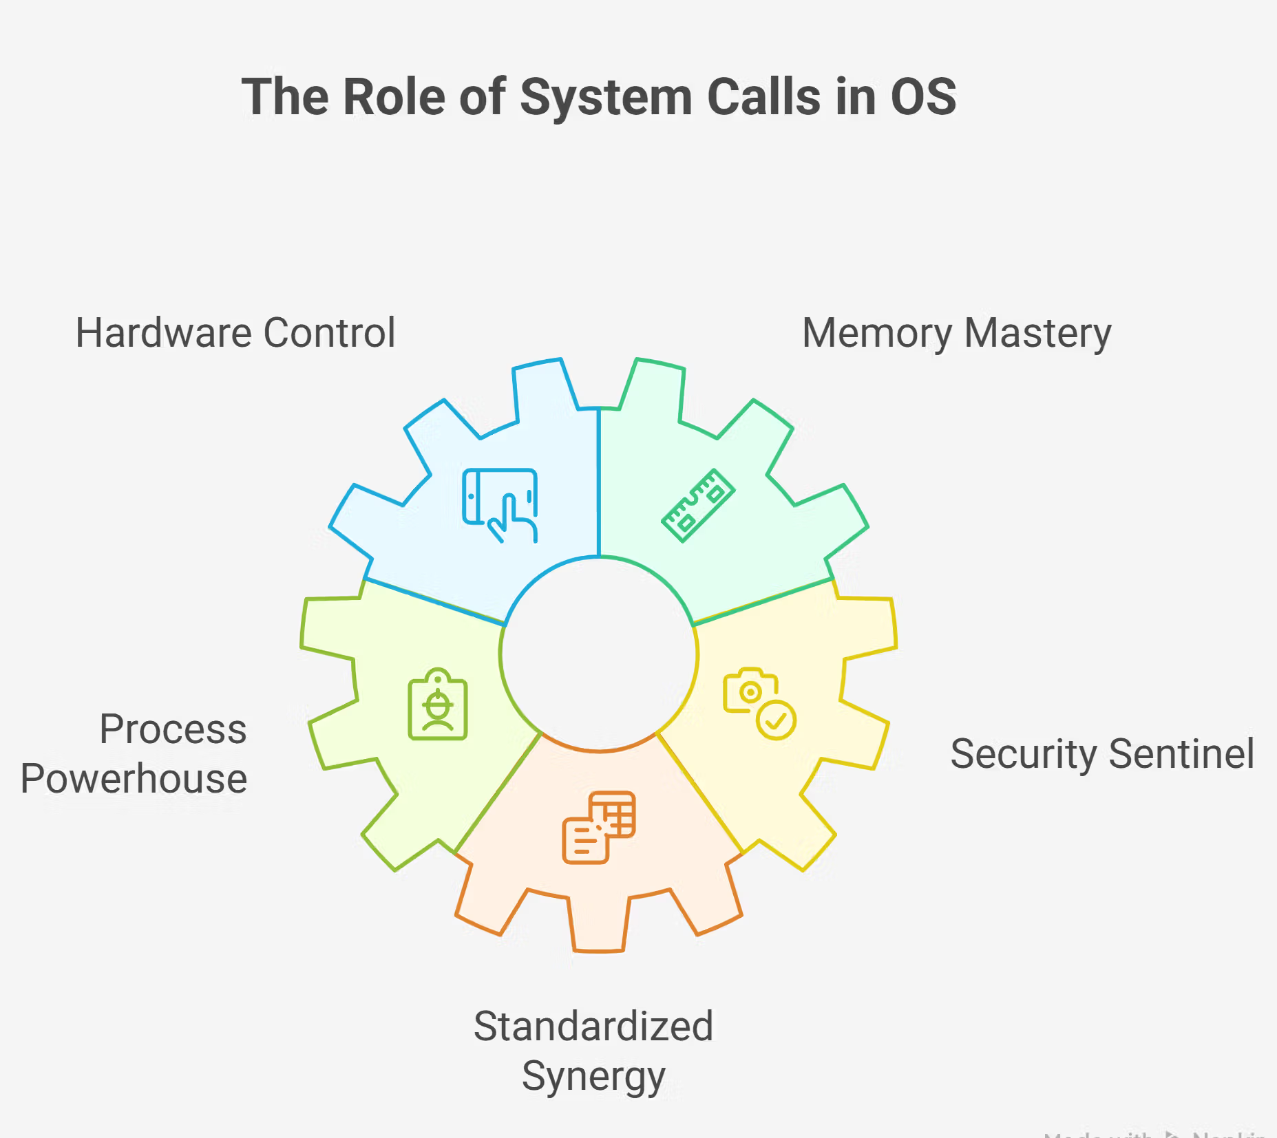
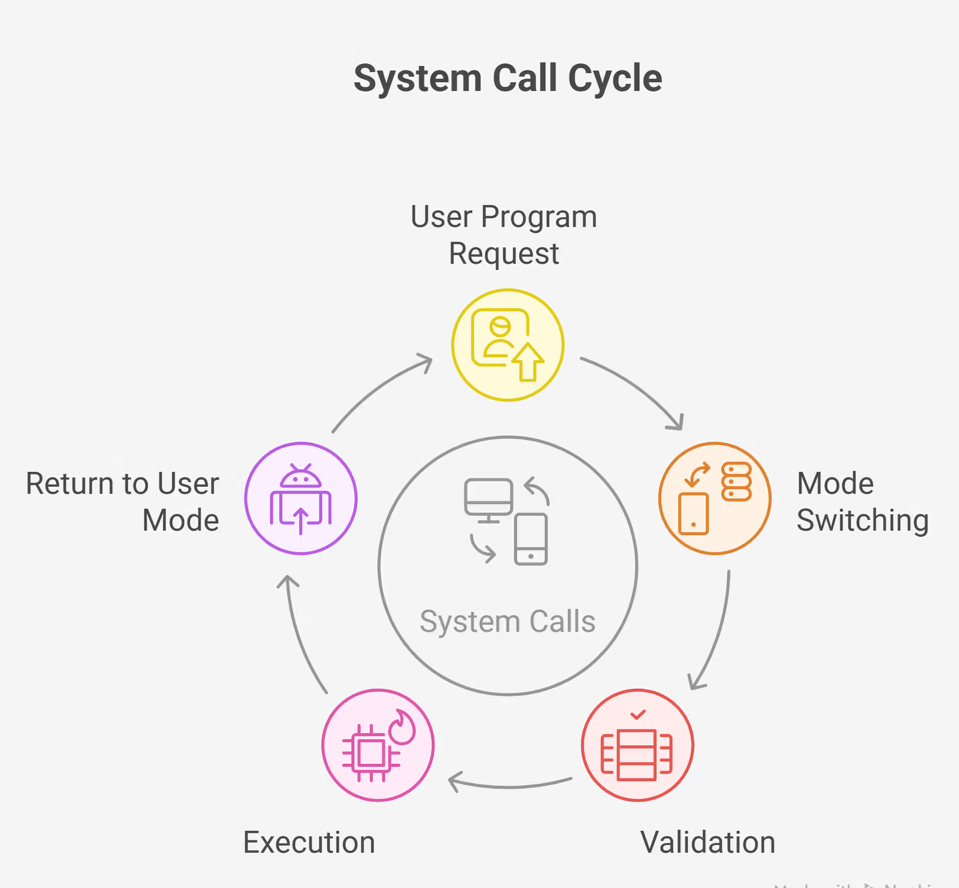
Tools & Technologies
Operating System: Linux / Ubuntu
Programming Language: C
Compiler: GCC
IDE/Editor: VS Code / Vim
Terminal: Linux Terminal
System Calls: fork(), kill(), signal(), wait(), getpid()
IPC Mechanism: Linux Signals
Version Control: Git & GitHub

Slide 9
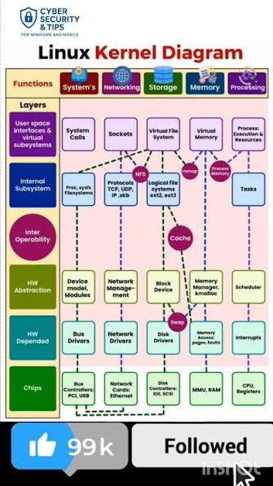
Expected Output
Successful creation of parent and child processes.
Processes communicate using Linux signals.
Correct response to signals such as SIGUSR1, SIGUSR2, and SIGTERM.
Real-time display of process IDs and status.
Controlled pause, resume, and termination of processes.
Demonstration of efficient signal-based IPC and process control.

Slide 10
THANK YOU

